Slide 1



ARvert: Cross-Functional Startup Collaboration
Team:
Sachin – Developer
Thamilchselvan – Project Manager
Pengcheng – Designer
Phurten – Marketing Lead

Slide 2

Project Idea – ARvert
Our startup, ARvert, is building an augmented reality advertising platform. With ARvert, users can scan real-world objects using their smartphones and instantly view interactive 3D ads, animations, or effects overlaid on their environment.
Our goal is to replace static, boring banner ads with engaging, immersive, and fun AR experiences that people actually want to interact with.

Slide 3

Team Roles
Sachin – Develops core AR technology.
Thamil – Manages timeline, tools, and meetings.
Pengcheng – Designs visuals, branding, and UI.
Phurten – Leads marketing outreach and brand partnerships.

Slide 4

Project Management Tools
Slack – Daily check-ins, quick discussions
Jira – Sprint planning and task tracking
Google Meet – Weekly video meetings
Google Drive – Shared space for files and folders

Slide 5
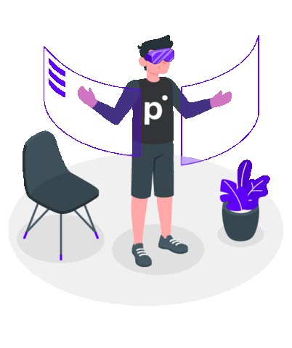

Opportunities & Strengths
Diverse skill sets and backgrounds
Creative freedom in designing our process
Fast learning and team ownership
Exciting tech – AR is trending
Strong potential for high user engagement

Slide 6

What if Someone Disagrees?
We pause and let everyone voice their view
Focus on data and project goals, not personal opinion
Use Slack poll or Jira comment thread to decide if needed
Conflict = chance to improve

Slide 7

What If We Can’t Access Data?
We identify if it’s a blocker or can be worked around
Use demo data or mockups to continue
Note the issue in Jira and assign someone to chase it down
Communicate early to avoid delays

Slide 8

No Shared Manager? No Problem
• Peer-to-peer resolution first
• Use team meetings or Slack to talk it out
• If stuck, Project Manager (PM) will initiate a calm, solution-focused 1-on-1 call
• Transparency = trust

Slide 9

Need to Talk to a Manager?
One person (usually Project Manager ) will handle communication
Approach: clear summary of the issue, options considered, and proposed solution
Focus on outcomes, not complaints

Slide 10

3-Week Plan (Jira Breakdown)
Week 1:
Define MVP (All)
First designs (Pengcheng)
Setup repo and base code (Sachin)
Week 2:
AR build + test (Sachin)
Brand outreach (Phurten)
Design refinements (Pengcheng)
Week 3:
Final demo + bug fixes (Sachin)
Prep slides + promo material (All)
Weekly reviews in Jira

Slide 11

Team Meeting Plan
Time Zones: EST
Weekly full sync on Google Meet (30 mins)
Daily async Slack updates
Mid-week optional design/dev check-in
Clear agenda shared before every Meet

Slide 12
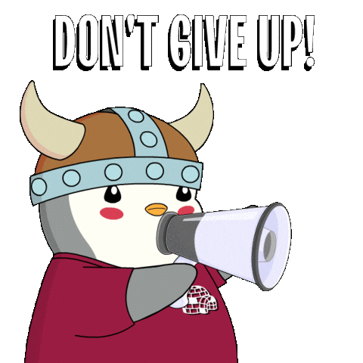
Challenges We Expect
Time zone gaps = slower replies
Lack of manager = unclear decision authority
Tech issues = possible blockers
Too many tools = confusion
How we handle it:
Slack updates + pinned Jira tasks
Small goals weekly
One source of truth: Jira

Slide 13

Creative Collab, Clear Ideas
Figma: UI mockups + feedback
Google Slides: Presentations
Google Drive: Organized folders by task
Everyone shares, updates, and reviews together
Creativity needs structure – we bring both

Slide 14

Thanks from Team AR-vert!
We’re building tech that brings ads to life
We’re building a team that works across time zones
We’re solving problems, together
Any questions?

